Slide 1
A New Open Source SMB2/3 Server Running on Windows in User Mode!
James Westland Cain, Ph.D Grass Valley, A Belden Brand
Version 0.6

Slide 2
Introduction – James Westland Cain
Principal Architect – Software @ Grass Valley
I code every day – as well as being arm waver in chief!
Been coding for nearly 40 years, at GV for nearly 20!
My research interests include file systems innovation and modern video production.
PhD in Advanced Software Engineering from Reading University
Visiting Research Fellow at Brunel University

Slide 3
My Previous SDC Presentations
2010: RESTful Filsystems: https://www.snia.org/sites/default/orig/sdc_archives/2010_presentations/thursday/JamesCain_RESTful_Filesystems.pdf
2011: Hidden Gems in the NAS Protocols: URL Missing
2013: Exploiting the High Availability features in SMB 3.0 to support Speed and Scale
https://www.snia.org/sites/default/files/files2/files2/SDC2013/SMB3/JamesCain_Exploiting_High_Availability_SMB30%20to%20support-v1.pdf
2015: A Pausable File System:
http://www.snia.org/sites/default/files/SDC15_presentations/file_sys/JamesCain_A_Pausable_File_System.pdf
2017: Programming the Path:
https://www.snia.org/sites/default/files/SDC/2017/presentations/File_Systems/Cain_James_Westland_Programming_the_Path.pdf (Video: https://www.youtube.com/watch?v=RNqYlQU_QX0 )

Slide 4
Agenda I
Introduction, Rationale & Competition
Code tour
Architecture
Building
Running
Plugins

Slide 5
Agenda II
What is working
Research Topics
Debts & To Dos
Ideas for projects

Slide 6
Learning Objectives I
Learn how elegant and simple the SMB2/3 protocol really is
Learn how hard it is to develop an SMB2/3 server.
Hint: we provide solutions for (some of) the hard bits ☺

Slide 7
Learning Objectives II
Learn how much of Windows can be re-used to develop an SMB2/3 server
Get some ideas of what you can do with a user mode file system for your own projects

Slide 8
Introduction
This talk is about writing an SMB2/3 server.
The server runs on Windows.
This has some interesting benefits
The server runs in user mode.
This also has some interesting benefits
The server is now open source
You can play too ☺

Slide 9
Rationale
Why implement SMB2/3 on Windows?
I have data I’d like to offer as files
The data is within the Windows eco-system.
Writing Kernel mode filesystems is notoriously hard
This approach is easier – honestly!
It’s a NAS not a DAS!
Having direct access to the SMB server offers many interesting benefits for filesystems innovation

Slide 10
Fuse Example Uses (from Wikipedia)
archivemount
CloudStore (formerly, Kosmos filesystem): By mounting via FUSE, existing Linux utilities can interact with CloudStore
EncFS: Encrypted virtual filesystem
ExpanDrive: A commercial filesystem implementing SFTP/FTP/S3/Swift using FUSE
FTPFS
GlusterFS: Clustered Distributed Filesystem having ability to scale up to several petabytes.
GmailFS: Filesystem which stores data as mail in Gmail
GVfs: The virtual filesystem for the GNOME desktop
KBFS: A distributed filesystem with end-to-end encryption and a global namespace based on Keybase.io service that uses FUSE to create cryptographically secure file mounts.
Lustre cluster filesystem will use FUSE to allow it to run in userspace, so that a FreeBSD port is possible.[8] However, the ZFS-Linux port of Lustre will be running ZFS's DMU (Data Management Unit) in userspace.[9]
MinFS: MinFS is a fuse driver for Amazon S3 compatible object storage server. MinFS[10] lets you mount a remote bucket (from a S3 compatible object store), as if it were a local directory
MooseFS: An open source distributed fault-tolerant file system available on every OS with FUSE implementation (Linux, FreeBSD, NetBSD, OpenSolaris, OS X), able to store petabytes of data spread over several servers visible as one resource.
NTFS-3G and Captive NTFS, allowing access to NTFS filesystems
Sector File System: Sector is a distributed file system designed for large amount of commodity computers. Sector uses FUSE to provide a mountable local file system interface
SSHFS: Provides access to a remote filesystem through SSH
Transmit: A commercial FTP client that also adds the ability to mount WebDAV, SFTP, FTP and Amazon S3 servers as disks in Finder, via MacFUSE.
WebDrive: A commercial filesystem implementing WebDAV, SFTP, FTP, FTPS and Amazon S3
WikipediaFS: View and edit Wikipedia articles as if they were real files
Wuala: A multi-platform, Java-based fully OS integrated distributed file system. Using FUSE, MacFUSE and Callback File System respectively for file system integration, in addition to a Java-based app accessible from any Java-enabled web browser (service discontinued in 2015).

Slide 11
Competition (on Windows)
Commercial Fuse like offerings on Windows:
https://www.callbacktechnologies.com/cbfsconnect/
Open Source Fuse like offerings on Windows:
https://github.com/dokan-dev/dokany
https://github.com/billziss-gh/winfsp
All use Kernel Mode drivers
This is hard!
They are local file systems
SMB2/3 is a network protocol …

Slide 12
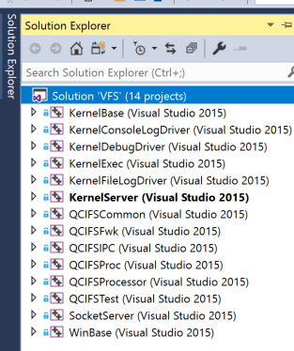
The Code – Architecture I
Approx 80k Lines of code
14 projects that build many DLLs, a LIB and one EXE that loads the DLLs.
Taken from a *much* bigger project that is millions of lines of code.

Slide 13
The Code – Architecture II
Written in C++ (pre-modern, so own smart pointers etc)
Uses Windows SDK and The Boost C++ libraries.
Builds to 64 bit Windows binaries.

Slide 14
The Code – Architecture III
The Kernel{*} projects have no knowledge of SMB2/3
They offer useful services that support the layers above
KernelServer is an exe that loads the DLLs.
KernelServer calls moduleInit on each DLL.
The DebugDiver catches GPFs and logs call stacks
There are two logging DLLs
A Console and A File Based Logger.
By default, file based logs are written to c:\data\logs

Slide 15
The Code – Architecture IV
The QCIFS{*} Dlls implement the SMB2/3 server code and offer some simple example file systems to play with.
QCIFSTest is a simple RAM only file and folder system.
QCIFSTest is a good place to start.

Slide 16
Building
README.md is in the root folder – start here.
Get Visual Studio (2015 or better),
Get a modern version of Boost (1.65.1 or better),
Configure a path to boost in the props file
Build a release build

Slide 17
Running I
How does it work?
It’s just a Network Server offering a well defined protocol.
We bind to port 445 and offer everything that an SMB2/3 server is expected to offer.
Run “RUNME.bat”

Slide 18
Freeing port 445
We need to free port 445 in order to bind to it!
Option 1: kill Server Service!
Option 2: (less nuclear) unbind the Server Service from port 445.

Slide 19
Free445
Use NetServerTransportEnum to find
"\\Device\\NetbiosSmb"
Use NetServerTransportDel to delete it.
This requires elevated privileges.
This gets re-set on the next windows reboot.
Free445 is a small project that does this.

Slide 20
NetManService
A more elegant way is to install a service, that can be run up each time we run KernelServer.
The NetManService does this.
It runs the same code as Free445
KernelServer does not normally need elevated privileges to run.
KernelServer only needs to be elevated when it installs the service - on first boot.

Slide 21
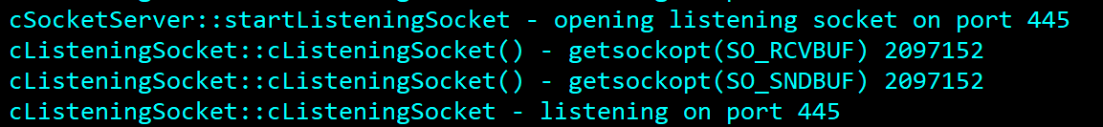
Running II
Now we can bind, so we can listen for TCP connections on port 445.

Slide 22
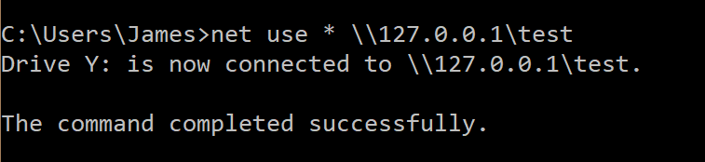
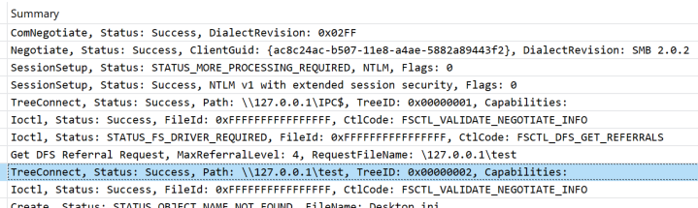
Loopback connection to the SMB2/3 server

Slide 23
Code to Handle SMBs
Project: QCIFSProcessor
(The name is a bit old now …)
Requests: cSMB2Request.cpp
Sessions: cSMB2Session.cpp
Responses: cSMB2Response.cpp

Slide 24
SMB Dispatch & Efficient Routing
cQCIFSPacketProcessor::AddPacket receives complete SMB packets from the wire.
Stack based cSMB2Request wrapped around wire payload.
cSMB2Request::dispatchCommand routes to one of 19 SMB handlers
cSMB2Request::getResponses uses pre-allocated buffers wrapped by cSMB2Response that formats bytes to go on the wire.
There are no memcpy calls in the pipeline
Use of Win32 IOCompletionPort and TransmitPackets API supports high speeds with low overhead. See SocketServer project.

Slide 25
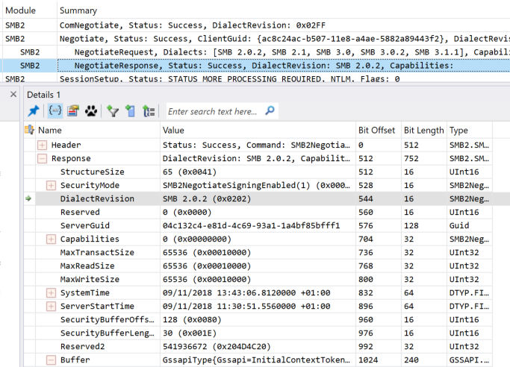
Protocol Version Negotiation
We need to negotiate a protocol version.
We choose the simplest (for now)

Slide 26
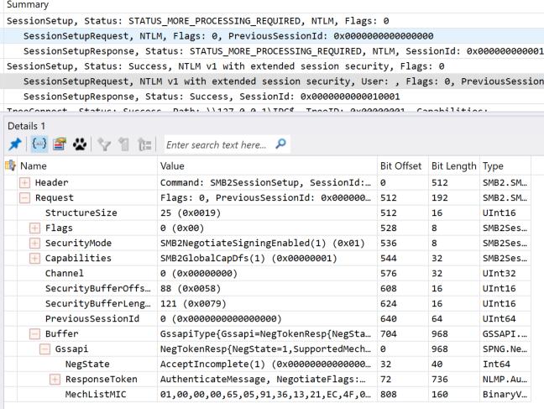
Session Setup
We then need to establish a secure session.
This generates the sessionKey for signing the session payloads.

Slide 27
Session Key Generation I
Windows Advantage: Use SSPI API!
PackageName = "NTLM"
QuerySecurityPackageInfo, AcquireCredentialsHandle, QueryContextAttributes, AcceptSecurityContext, CompleteAuthToken, DeleteSecurityContext, FreeContextBuffer, FreeCredentialsHandle.

Slide 28
Session Key Generation II
Windows Advantage: Use Bcrypt API!
BCRYPT_RC4_ALGORITHM, BCRYPT_MD5_ALGORITHM, BCRYPT_SHA256_ALGORITHM, BCRYPT_ALG_HANDLE_HMAC_FLAG, BCRYPT_AES_CMAC_ALGORITHM.

Slide 29
NTLM v2 Authentication - Algorithm
NTOWFv2(Passwd, User, UserDom) HMAC_MD5(MD4(UNICODE(Passwd)), UNICODE(ConcatenationOf( Uppercase(User), UserDom ) ) )
"NTOWFv2("Password", "User", "Domain") is
0c 86 8a 40 3b fd 7a 93 a3 00 1e f2 2e f0 2e 3f
Taken from [MS-NLMP]: NT LAN Manager (NTLM) Authentication Protocol

Slide 30
NTLM v2 Authentication - Code
Buffer NTOWFv2(Buffer& password, Buffer& user, Buffer& domain) {
Buffer md4Psswrd;
hashVal(BCRYPT_MD4_ALGORITHM, password, md4Psswrd);
Buffer userAndDom;
NT_VERIFY(userAndDom.Create(user.GetSize() + domain.GetSize()));
memcpy(userAndDom.GetData(), user.GetData(), user.GetSize());
memcpy(userAndDom.GetData() + user.GetSize(), domain.GetData(), domain.GetSize());
return HMAC_MD5(md4Psswrd, userAndDom);
}

Slide 31
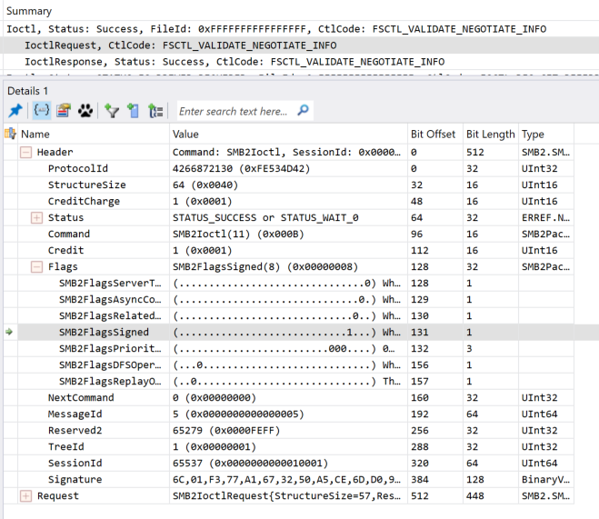
Validate Negotiate Info
A server must handle this FSCTL or the client will disconnect.
The SMB is signed, so the reply must be signed too.
Signing requires the session key.

Slide 32
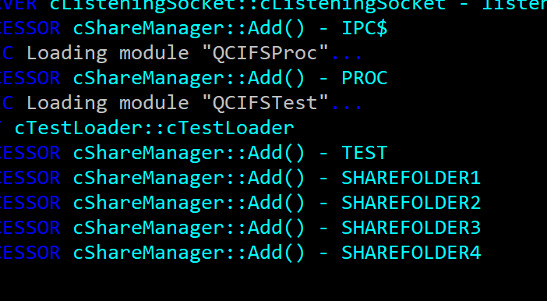
VFS - Adding Shares I
Class iQCIFSProcessor is a singleton (it registers using some KernelExec macros).
iQCIFSProcessor::singleton().attachResource(..) is used to add new share names to the SMB server.

Slide 33
VFS - Adding Shares II
QCIFSProcessor module receives and returns payload bytes to the SocketServer.
iQCIFSFwk::singleton().createTreeResourceFactory() returns iTreeResourceFactory instances suitable to be passed to iQCIFSProcessor::attachResource().
QCIFSFwk module offers lots of boiler plate code to support default implementations – enabling easy File System Development.

Slide 34
QCIFSTest – An Example File System I
A very simple basic file system driver.
It can offer readonly files from local disk and RAM only mutable files and folders.
Its small …
| extension| total code| total comment| total blank|percent|
-------------------------------------------------------------------------
| .cpp| 421| 169| 146| 47|
| .h| 161| 171| 99| 18|

Slide 35
QCIFSTest – An Example File System II
createTreeResourceFactory expects an iChildLoader instance.
QCIFSTest implements a class cTestLoader : public cChildLoader, public iCreate, public iRename, public cRefCount
Inherit from:
cChildLoader – Base implementation that returns the children of this folder by implementing void registerListener(const vfs::cPtr<iChildLoaderVisitor> pChildListener)
iCreate – adds creation support for files and folders
iRename – adds rename support
cRefCount – mixin reference count to enable our smart pointer

Slide 36
QCIFSTest – An Example File System III
The iChildLoaderVisitor interface offers lots of ways to add files and folders to this folder, using various overloads on updateFolder and updateFile.
Variations on types of folder functionality can be built using interfaces previously mentioned (iChildLoader, iCreate, iRename, etc).
Variations on types of files can be built by inheriting from interfaces such as iReadCallback or iWriteCallback.

Slide 37
Example File System – Adding Folders
virtual void iChildLoaderVisitor::updateFolder(const vfs::String& sName
, const vfs::cPtr<iChildLoader> pChildLoader
, const vfs::cPtr<iRename> pRename
, const vfs::cPtr<iCreate> pFolderCreate
, const vfs::cConstPtr<vfs::cMemoryView> pIconMem
, const vfs::cPtr<iFileEvent> pFileEvent = vfs::cPtr<iFileEvent>()
, const bool bDeletable=false
, const bool bNotify = true) = 0;

Slide 38
Example File System – Adding Files
virtual void iChildLoaderVisitor::updateFile(
const vfs::String& sName
, vfs::cPtr<iReadCallback> readCallback
, const vfs::cPtr<iFileEvent> pFileEvent = vfs::cPtr<iFileEvent>()
, bool bDeletable = true
, const bool bNotify = true) = 0;
virtual void iChildLoaderVisitor::updateFile(
vfs::cPtr<iWriteCallback> writeCallback
, const vfs::String& sName
, bool bDeletable = true
, const bool bNotify = true) = 0;

Slide 39
Example File System – Readonly Files
class iReadCallback {
public:
virtual ~iReadCallback() {}
virtual unsigned __int64 getSize(ULONGLONG fid) = 0;
virtual DWORD readBytes(tTransmitList &krTPM, DWORD& nBytes, const LARGE_INTEGER &nOffset, const int sessionID, ULONGLONG fid) = 0;
virtual bool canExecute() { return false; }//defaults to no execution rights
virtual bool canCache() { return true; }//defaults to SMB2 BATCH OPLOCK
virtual DWORD registerChangeListener(vfs::cPtr<iCallbackChangeListener> listener) = 0;
virtual DWORD close(ULONGLONG fid) {return 0;}
};

Slide 40
Example File System – Mutable Files
class iWriteCallback : public iReadCallback {
public:
virtual DWORD setSize(unsigned __int64 newSize) = 0;
virtual DWORD writeBytes(vfs::cConstPtr<vfs::cMemoryView> buffer, const LARGE_INTEGER &offset, const int sessionID) = 0;
};
class iFileEvent {
public:
virtual ~iFileEvent(){}
virtual DWORD notifyDelete() = 0;
};

Slide 41
Example file implementation classes
class cBasicFile : public iReadCallback, public cRefCount
Takes a path to a local file and offers it to the VFS as a read only byte range.
class cTestWriteCallback : public iWriteCallback, public iRename, public iFileEvent, public vfs::cRefCount
Created inside cTestLoader::File, added to iChildLoaderVisitor using updateFile.
cTestLoader::Directory creates extra instances of cTestLoader to support sub directories.

Slide 42
It’s not just a DAS – it’s a NAS I
The competition listed in the front matter were all using IFSKit style Kernel mode drivers to build loopback filesystems.
Our VFS is a NAS protocol server.
Its so much more than just Loopback!
Its has been tested against numerous clients, including OS-X, Linux, Solaris and Windows.
No warranties though ☺

Slide 43
It’s not just a DAS – it’s a NAS II
The real advantage of being a NAS server comes with more modern SMB3 features.
SMB3 offers clustering for scale out and failover.
The SMB3 protocol has been used in very interesting and demanding deployments, such as storage for booting Hyper-V images.

Slide 44
Protocol Research I
Credits – see QCIFSProcessor Main.cpp
Defaults to 40 – plenty for loopback
Can be overridden using registry
See moduleInit in QCIFSProcessor project.

Slide 45
Protocol Research II
Protocol Versions - #define kUSE_SMB3
Enables v3 negotiation
SMB3 uses different session key calculation.
SMB3 supports: SMB2_SHARE_CAP_CONTINUOUS_AVAILABILITY, SMB2_SHARE_CAP_CLUSTER, SMB2_SHARE_CAP_SCALEOUT

Slide 46
Protocol Research III
SMB3 experiments:
#define kUSE_SMB_NETWORK_INTERFACE_INFO
Supports experiments with FSCTL_QUERY_NETWORK_INTERFACE_INFO

Slide 47
Debts – Signing & Encryption
Debt: Sign All The Time
Status: Single packets work.
Multiple (compound) packets don’t.
Need to configure OS-X to work around
Debt: Encryption
Not supported

Slide 48
Things to add – Enum Shares I
Support net share enumerations via ‘srvsvc’.
OS-X needs srvsvc to re-connect after an error / timeout etc & Finder needs it anyway.
On Windows loopback try command
net view 127.0.0.1
Use MIDL compiler to make C code for the srvsvc IDL and ms-dtyp.idl.

Slide 49
Things to add – Enum Shares II
Approach: use local named pipe (so LPC) to our own srvsvc!
Pump binary using read write IO.
Semantics: Transact is blocking, read & write is async.
Test approach using: NetShareEnum(NULL, 0, &buf, MAX_PREFERRED_LENGTH, &entries, &total, NULL);

Slide 50
Other Service Function Calls
OX-X calls SRVS: BIND & NetShareEnum.
Explorer calls SRVS: BIND & NetrShareEnum, NetrServerGetInfo, NetrShareGetInfo.
Explorer calls WKST: BIND & NetrWkstaGetInfo.

Slide 51
Things to add – RIO?
Complement IOCompletionPort with RIO
Registered I/O - API to support high-speed networking for increased networking performance with lower latency and jitter.
RIO relies on registering the memory that you will use as data buffers and knowing in advance how many pending operations a given socket will have at any time.

Slide 52
Project: Clustering
The VFS code base supports some of the SMB3 extensions for multi-channel, scale out and clustering.
I gave a talk about the semantics of the implied model between a set of SMB3 cluster members here in 2013
It would be interesting to build a clustered VFS using this code base, as we can again exploit some of the Windows ecosystem to support this.

Slide 53
Project: SMB Direct – In User Mode ???
SMB3 multi-channel enables different transports, like SMB Direct.
NDKPI is an MS Kernel Mode API for RDMA access.
The MS HPC team use NDSPI – as user mode equivalent to the Kernel Mode API.
NDSPI is very poorly documented, but its API is a mirror of NDKPI, which is well documented.
Ports are either 445 for Infiniband, or 5445 if TCP ports are in use (this new number is registered with IANA).
We can use the same NetServerTransportEnum techniques to free ports

Slide 54
Legal
The code is open source.
The code is Licensed under the Apache License, Version 2.0 …
… so really … no WARRANTIES !
See here for the full terms:
http://www.apache.org/licenses/LICENSE-2.0

Slide 55
Git Clone
The Code is hosted on Github.com
The URL to clone from is https://github.com/DrJWCain/VFS
Please fork freely, and send pull requests if you want to.
I’m very excited to see what the community make of this!

Slide 56
Questions?
Email: james.cain@grassvalley.com
Clone from: https://github.com/DrJWCain/VFS

